Slide 1
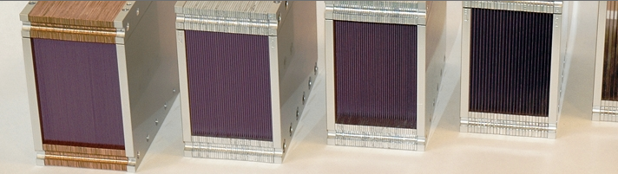
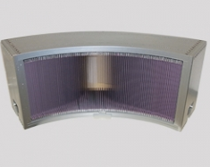
5.1 STATIONARY BEAM TAILORING
(slits and collimators)
collimator photos from :
http://www.jjxray.dk
Slits and Collimators

Slide 2

5.1 STATIONARY BEAM TAILORING
(slits and collimators)
In this session:
Overview of existing Slit and Collimator components
Detailed description of the most commonly used ones
How to ‘call’ them into a *.instr file
Practical Exercise using Collimators
IMPORTANT:
All (and more) of this information can be found in the online pdf component documentation
http://www.mcstas.org/documentation/manual/mcstas-2.4.1-components.pdf
also distributed with your McStas installation
The component documentation along with the “mcdoc component_you_are_searching_for” command, are your best friends when using McStas
Slits and Collimators

Slide 3
5.1 STATIONARY BEAM TAILORING
(slits and collimators)
Slit (and slit-like) components:
Slit.comp
Beamstop.comp
CavitiesIn.comp
CavitiesOut.comp
Collimators:
Collimator_linear.comp
Collimator_radial.comp
Collimator_ROC.comp
Exact_radial_coll.comp
Slits and Collimators

Slide 4
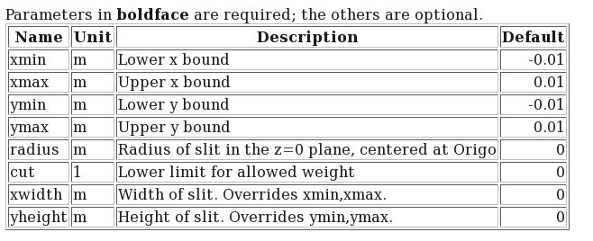
SLITS
Slit.comp
A beam defining diaphragm
Example:
COMPONENT input_slit = Slit(xmin=-0.01, xmax=0.01, ymin=-0.01,
ymax=0.01)
Slits and Collimators

Slide 5
SLITS AND COLLIMATORS
Slits and Collimators

Slide 6
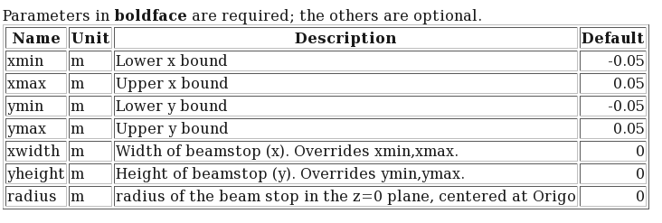
SLITS
Beamstop.comp
A neutron absorbing area
Example:
COMPONENT stopbeam = Beamstop(xmin=-0.01, xmax=0.01, ymin=-0.01,
ymax=0.01)
COMPONENT stopbeam = Beamstop(radius=0.01)
Slits and Collimators

Slide 7
SLITS AND COLLIMATORS
Slits and Collimators

Slide 8
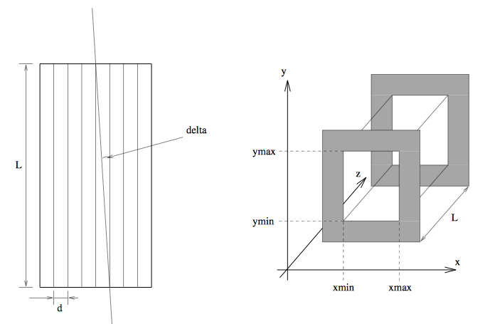
COLLIMATORS
Collimator_linear.comp
A simple Soller blade collimator
Slits and Collimators

Slide 9
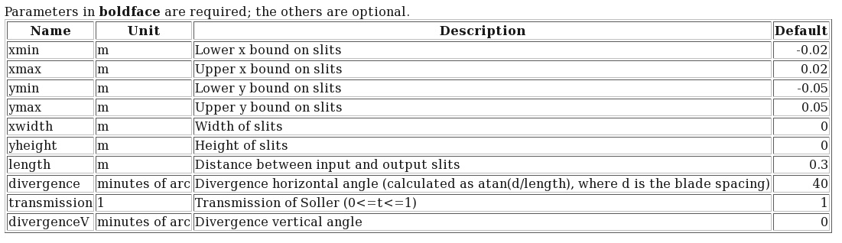
COLLIMATORS
Collimator_linear.comp
A simple Soller blade collimator
Example:
COMPONENT lin_coll = Collimator_linear(xmin=-0.1, xmax=0.1, ymin=-0.1,
ymax=0.1,length=0.25,
divergence=40,transmission=0.7)
Slits and Collimators

Slide 10
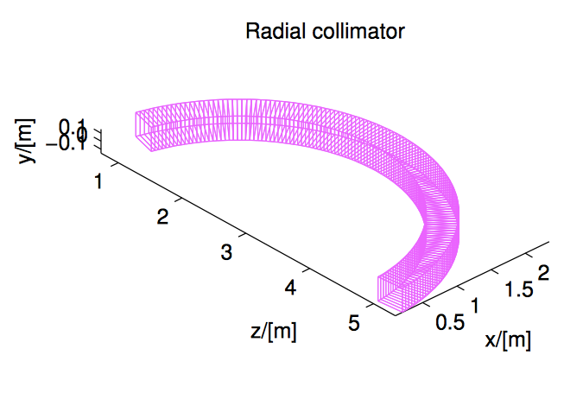
COLLIMATORS
Collimator_radial.comp
A radial Soller blade collimator
Slits and Collimators

Slide 11
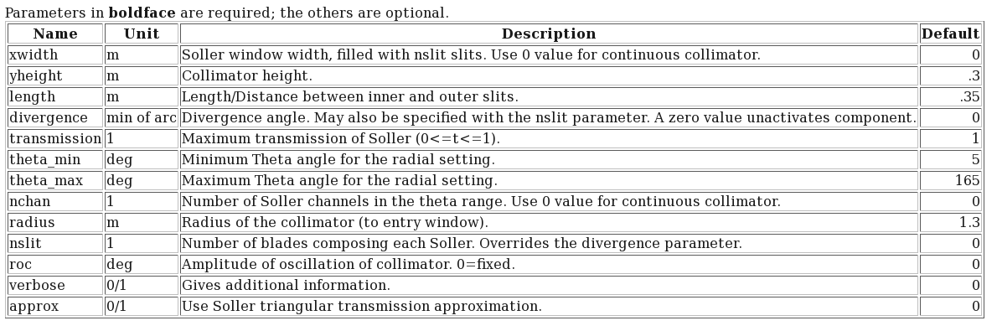
COLLIMATORS
Collimator_radial.comp
A radial Soller blade collimator
Example:
COMPONENT rad_coll = Collimator_radial(xwidth=0.015, yheight=0.3,
length=0.35, divergence=40.0, transmission=1,
theta_min=5, theta_max=165, nchan=128, radius=0.9)
Slits and Collimators

Slide 13

COLLIMATORS
EXERCISE
Open the existing instrument file named ‘Test_Collimator_Radial_ex.instr’ (you will find it in today’s class folder)
This instrument file compares the performance of the ‘Collimator_Radial’ and ‘Collimator_ROC’ components. The user is requested to give an input parameter: 1 for choosing the radial collimator and 2 for using the ROC collimator.
Before running the instrument file, spend some time reading it and understanding what components it calls and what it does:
What source is used? What type of monitors are used and what do they do?
What is the functionality of the following lines placed after the sample component?
EXTEND %{
if (!SCATTERED) ABSORB;
%}
The file contains 2 collimator components!! Notice after each one of them the usage of a ‘WHEN ...’ statement. What does that do? (HINT: take a look at the content of the ‘INITIALIZE’ part of the file.)
Slits and Collimators

Slide 14
COLLIMATORS
EXERCISE
Run the ‘Test_Collimator_Radial_ex.instr’ with 1e7 neutrons
a) with Collimator =1 (i.e. using the Collimator_radial component)
b) with Collimator = 2 (i.e. using the Collimator_ROC component)
Compare the results. Do the two different collimators perform similarly?
Expand the ‘Test_Collimator_Radial_ex.instr’ file, adding a third options, where the file
uses the ‘Exact_Radial_Coll.comp’ component, when the parameter Collimator=3. How does this collimator perform, compered to the previous 2?
Slits and Collimators

